Slide 1
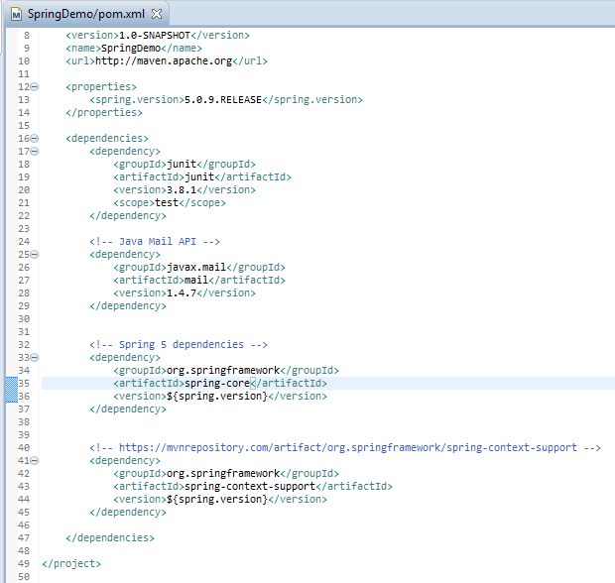
Sending E-mail via Gmail SMTP server with MailSender in Spring
Add the JavaMail and Spring’s dependency.

Slide 2
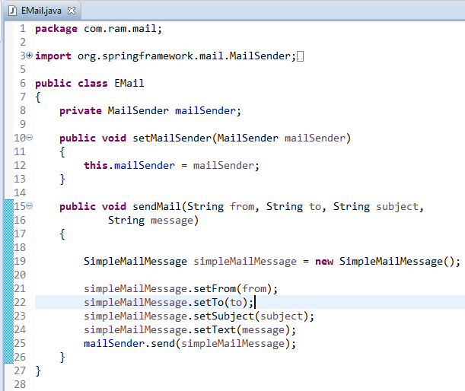
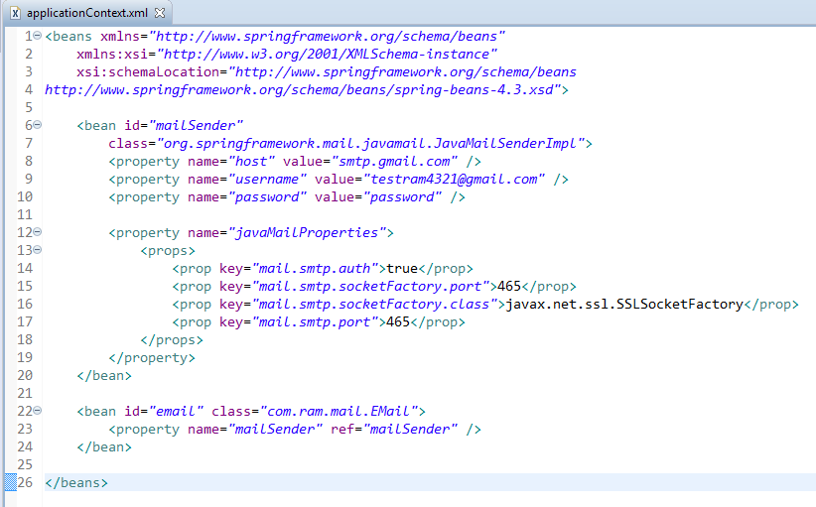
Sending E-mail via Gmail SMTP server with MailSender in Spring

Slide 3
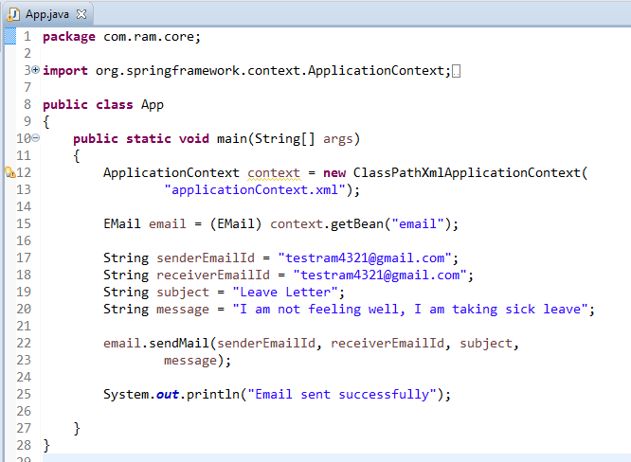
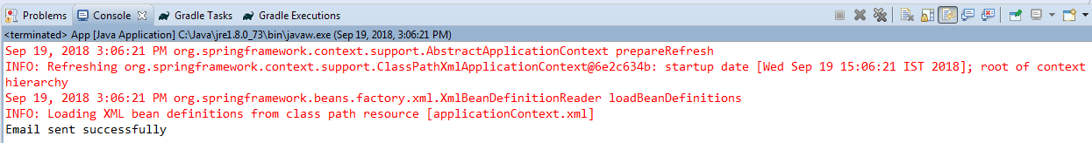
Sending E-mail via Gmail SMTP server with MailSender in Spring

Slide 4
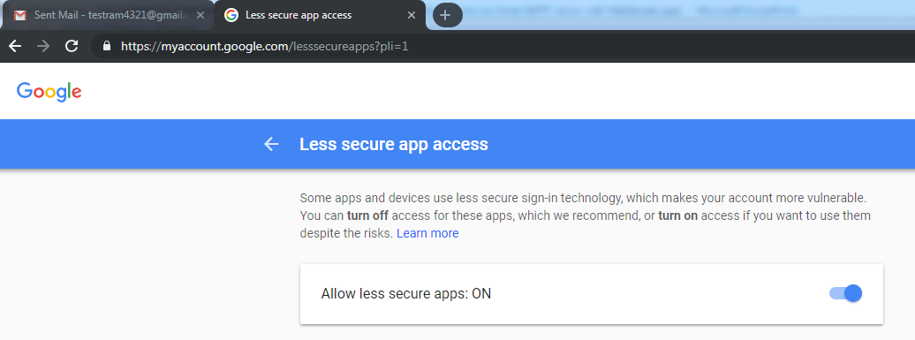
Sending E-mail via Gmail SMTP server with MailSender in Spring
To resolve javax.mail.AuthenticationFailedException is thrown while sending email in java
Go Login from Your browser from that email. I had problem with google if it is google go here :https://www.google.com/settings/security/lesssecureapps
you will see turn off or turn on. Click "Turn on"
Then try your code again it will work

